Slide 1
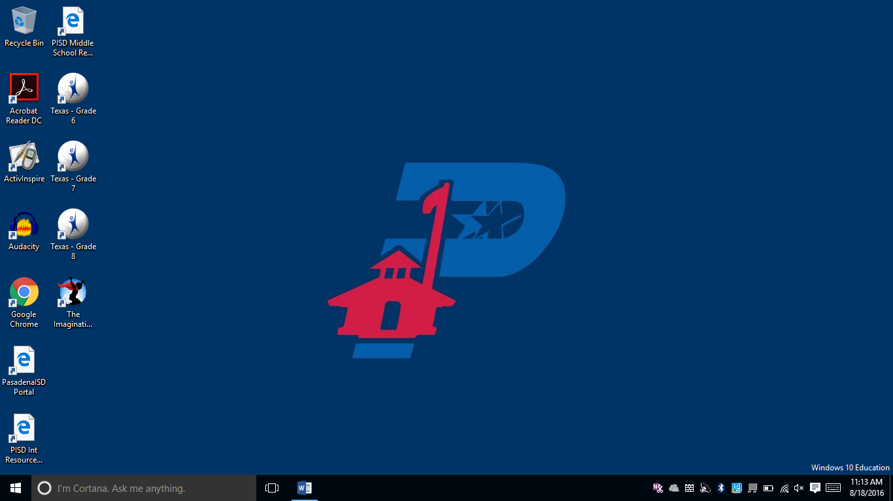
ALL DEVICES EXCEPT CHROMEBOOKS:
Open Chrome.

Slide 2
ALL DEVICES EXCEPT CHROMEBOOKS:
In the address bar at the top of the screen, type tinyurl.com/maptest1819.

Slide 3
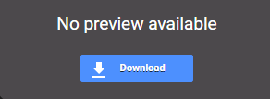
ALL DEVICES EXCEPT CHROMEBOOKS:
Click on the blue Download button in the middle of the screen if you see it.
NOTE: The file may download automatically without showing this button.

Slide 4
ALL DEVICES EXCEPT CHROMEBOOKS:
You should see the file downloading in the bottom left corner of the screen. Once the download is complete, click on the file.
This is what the file will look like once the download is complete.

Slide 5
ALL DEVICES EXCEPT CHROMEBOOKS:
Click the Yes button regarding changes being made to your PC.

Slide 6
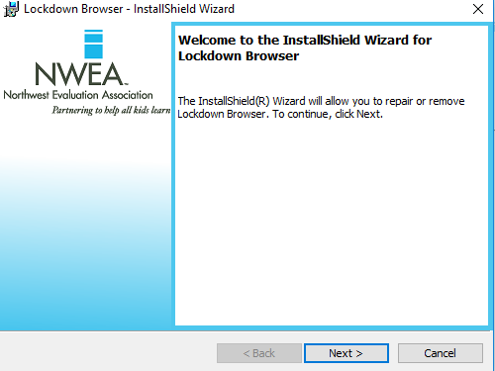
ALL DEVICES EXCEPT CHROMEBOOKS:
When the InstallShield Wizard window opens, click the Next button.

Slide 7
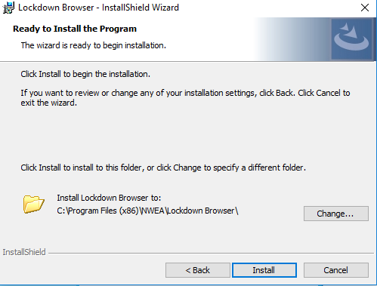
ALL DEVICES EXCEPT CHROMEBOOKS:
Click the Install button.

Slide 8
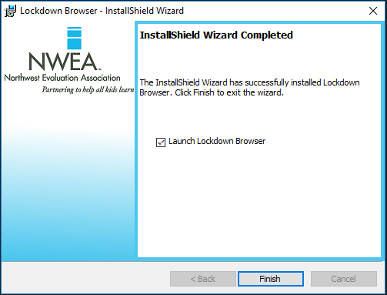
ALL DEVICES EXCEPT CHROMEBOOKS:
Place a check in the Launch Lockdown Browser box. Click the Finish button.
Click for instructions to start the test.

Slide 9
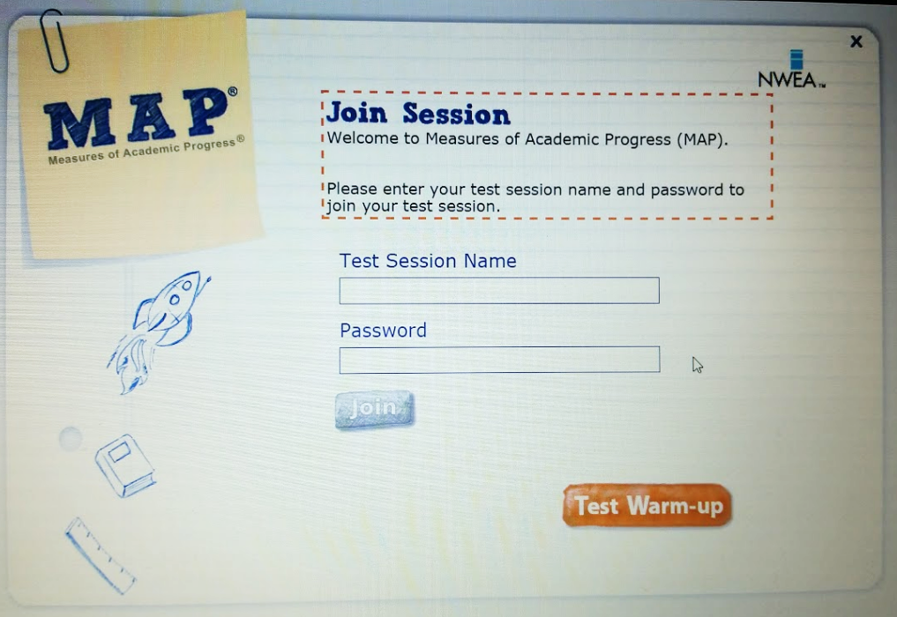
Once you see the Join Session screen, wait for further instructions from your teacher.

Slide 10
For those who installed the lock-down browser:
To return to the MAP Test screen at a later time, click the Windows icon in the bottom left corner of the screen.

Slide 11
For those who installed the lock-down browser:
Start typing nwea. The search window will open automatically and you should see NWEA Lockdown Browser appear in the search box. Select NWEA Lockdown Browser.

